Slide 1
PEDESTRIAN
SECONDHAND SMOKE
Reina Dissa & Mateo Alexander

Slide 2
PURPOSE
Examine exposure to secondhand smoke in respect to people’s pedestrian movement.
Picture source: Holly Adams/Bloomberg

Slide 3
The study examines the neighborhoods of Morningside Heights, Bloomingdale District, and Manhattan Valley.

Slide 4
HYPOTHESIS
More people are smoking in front of bars, deli, restaurants, and smoke shops
People are smoking at the same spot. We can learn for numbers of cigarette litter around.
Secondhand smoke radius

Slide 5
RESEARCH QUESTION
How harmful could secondhand smoke be while walking past cigarette smokers?

Slide 6
HOW?

Slide 7
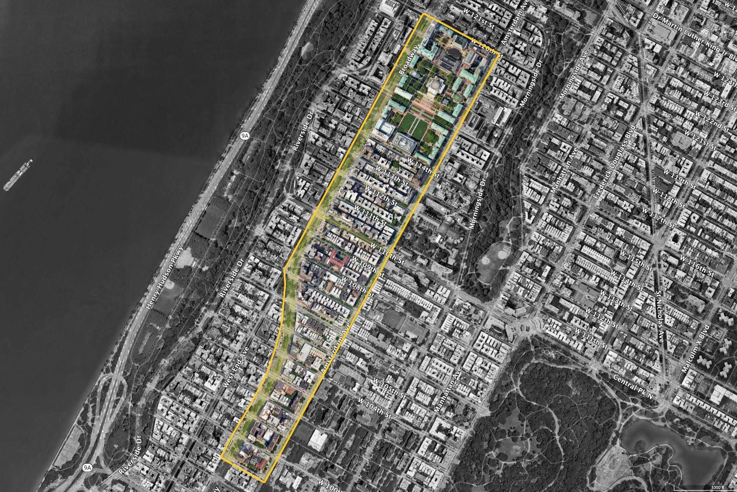
THE OBSERVATION AREA
Columbia University
Amsterdam Avenue
Broadway

Slide 8
THE SCHEMATIC
LCD 16x2
A small LCD screen module for Arduino
MQ-135 SENSOR
Air Quality Sensor Hazardous Gas Detection Module for Arduino
12V FAN
PC 50mm 12V Fan
Thanks to circuito.io 🥹

Slide 9
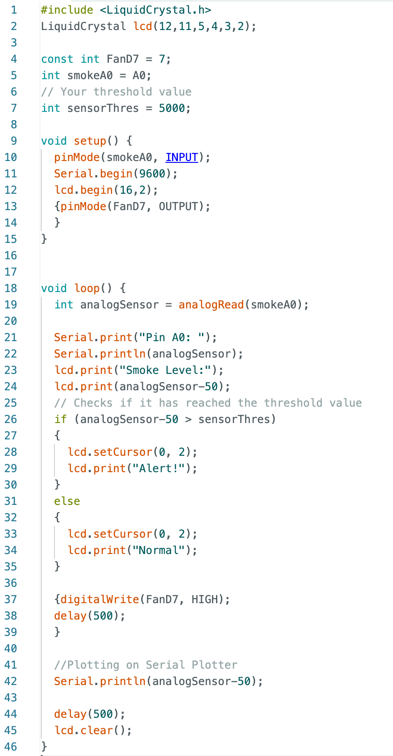
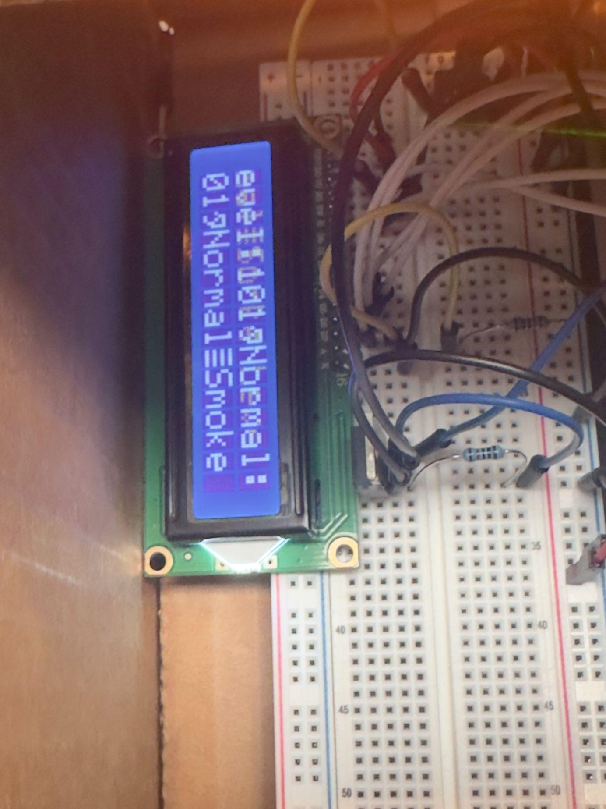
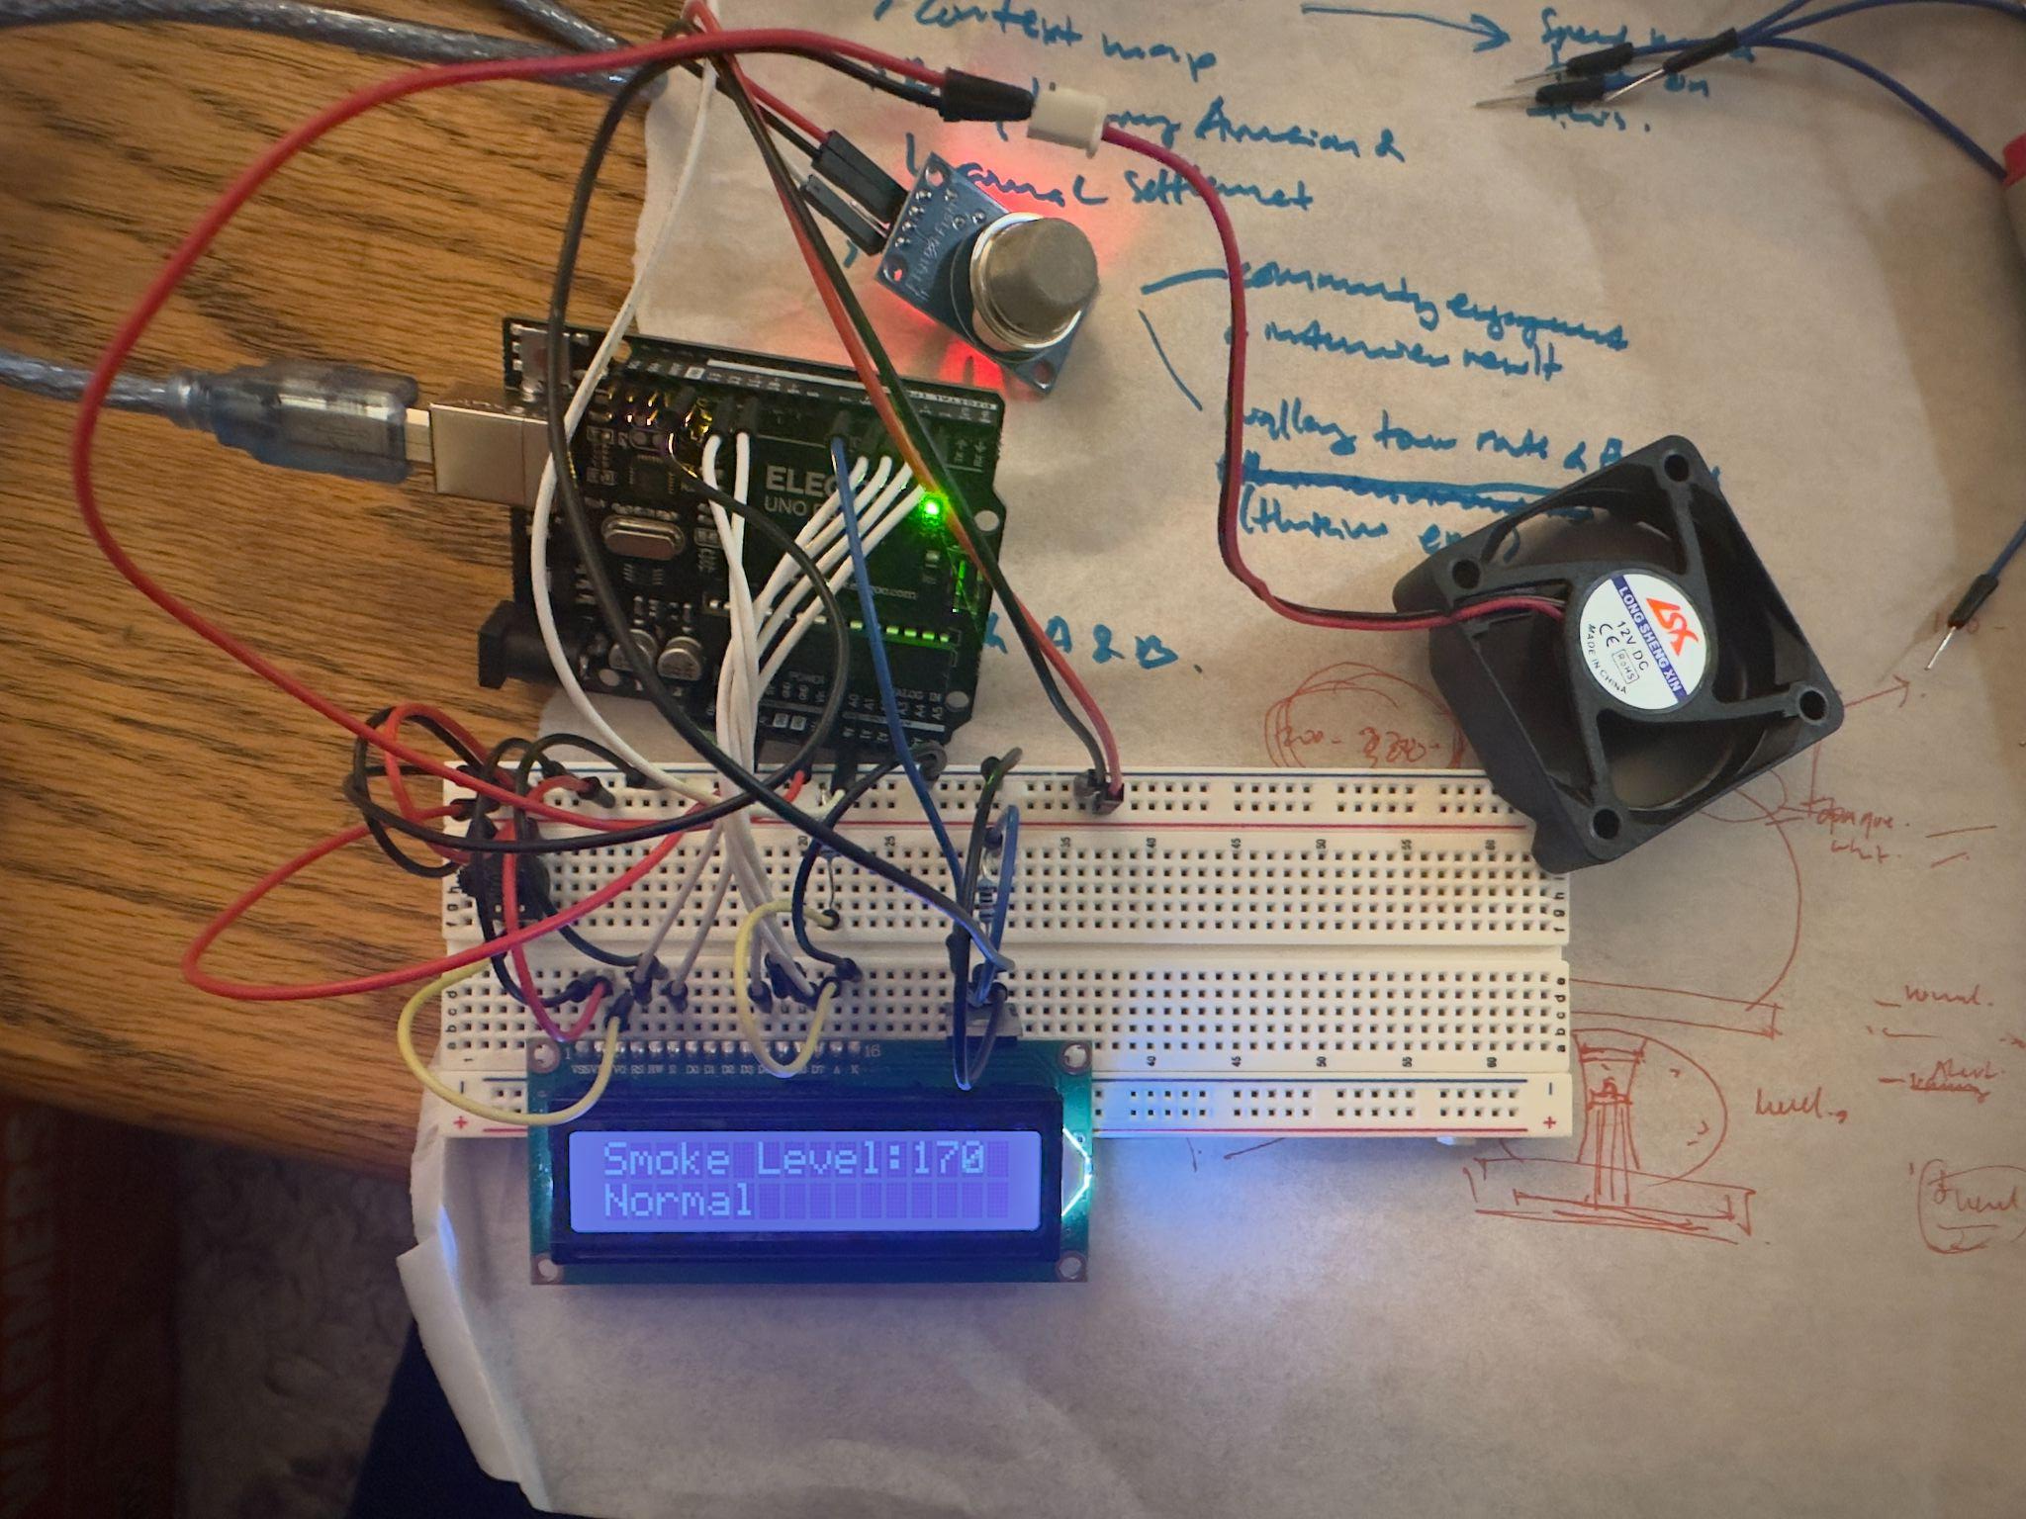
THE PROCESS

Slide 10
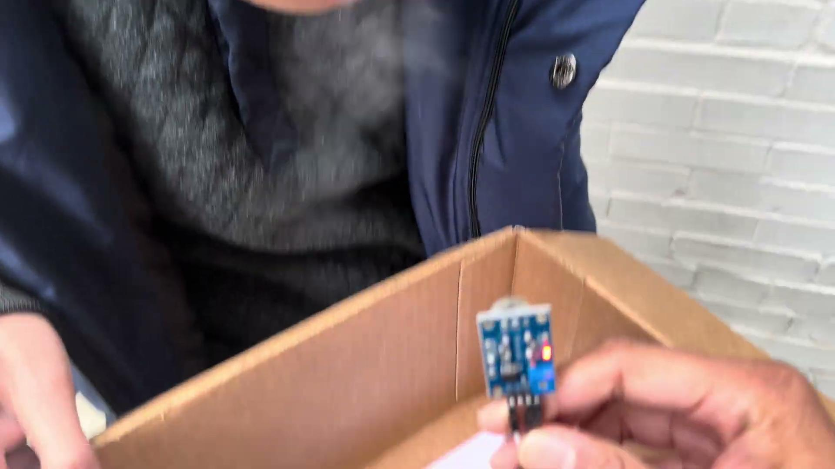
TESTING OUT

Slide 11
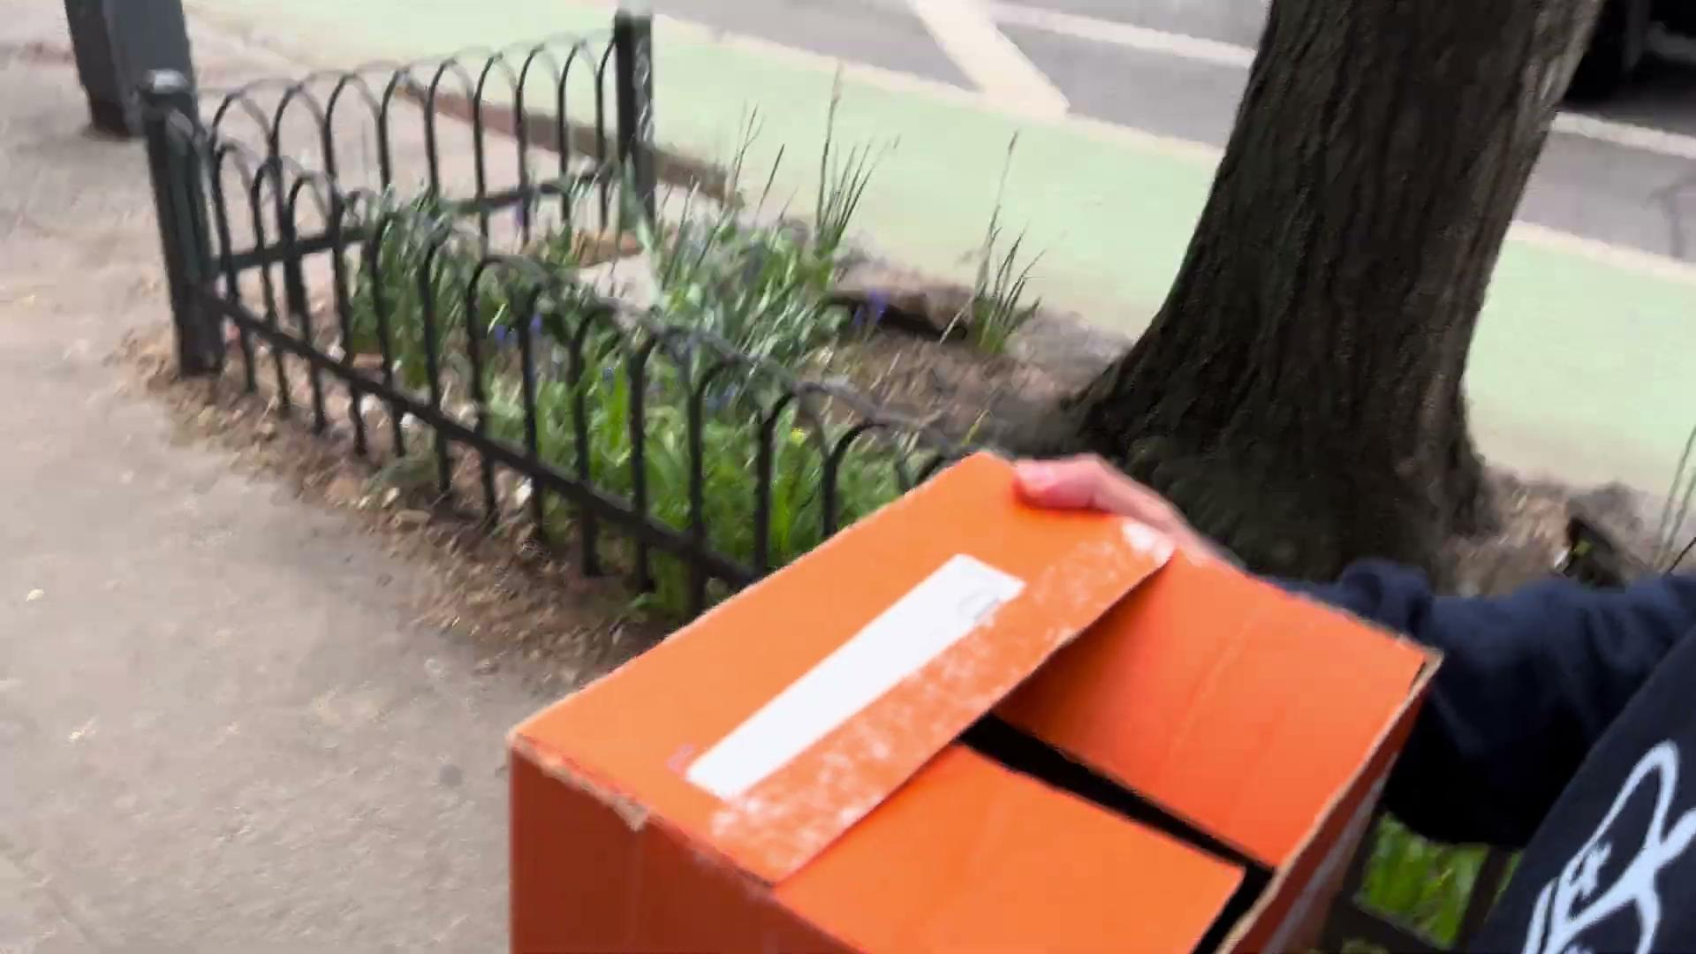
TRIAL RUN

Slide 12
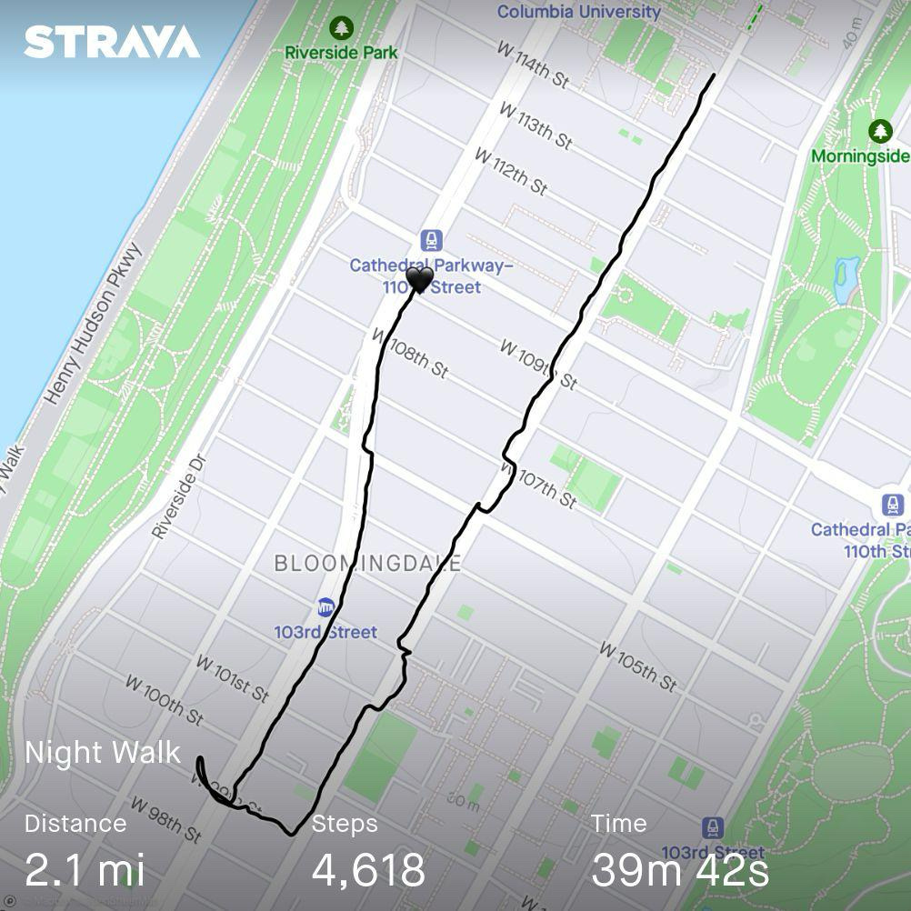
START
THE
OBSERVATION
FINISH OBSERVATION
STRAVA
START

Slide 13
WHERE WE FOUND SMOKERS*
The areas where smokers were observed are depicted in blue Xs.
*) by the time when we did the observation

Slide 14
FINDINGS
trial run and the observation
The quality affected by other aspects of the urban environment
Smoking style and etiquette
Cues from cigarette butts

Slide 15
RESULT
walking by a smoker
The AQI after passing a smoker generally increased, staying within a range of 7 to 20 AQI points.

Slide 16
LIMITATIONS
Longer time to initial calibration due to sensor’s sensitivity
Delays on data taking. LCD not showing the real time result
Limitation on time for data taking at different time periods to create more detailed and accurate analysis
The 1-second intervals on data taking created large files dataset.

Slide 17
* People are affected by secondhand smoke. This might not be by a significant amount, but it does have an affect on the personal experiences of individuals.
* An average of 2-5 smokers per walking session makes it difficult to measure pedestrian secondhand smoking. In order to measure the effects of secondhand smokers, higher frequencies of smokers need to be measured.
WHAT WE CAN LEARN
Difficult to measure pedestrian secondhand smoke due to number of smokers found (avg. 2-5 smokers)
People might be affected by secondhand smoke accidentally
Take into account factors such smoking styles or smoking etiquette
For future iterations, several different kinds of sensors could be utilized for data triangulation

Slide 18
FUTURE?
Air quality alone does not tell a whole story, but could contribute to a more holistic story when paired along other data, such as some from olfactory sensors.
Understanding several individual experiences can help to create a collective narrative about public health in commuting at the urban and regional scale.

Slide 19
THANK YOU

Slide 20
LImitations
*In primary runs, there air quality seemed to volatile at first. The sensor generally needed some time to calibrate before trial runs because of its sensitivity.
*There were some delays on the data taking because of the 1-second intervals observation, therefore the data shown in the lcd is not really showing real-time
*Data collection typically consisted of large files granted that each walking route was observed in 1-second intervals to ensure that the intracies of the personal experience were captured. It took significant time to comb through the data to find the smoking scenarios even with manual timestamps.
* The research team was unable to perform measurements during several different times of day. Limitations in our committments created limited time frames for data collection, not allowing for data collection at several different time periods

Slide 21
conclusions
* People are affected by secondhand smoke. This might not be by a significant amount, but it does have an affect on the personal experiences of individuals.
* While this study looked primarly at us as individuals, understanding several individual experiences can help to create a collective narrative about public health in transportation at the urban and regional scale.
*Air quality alone does not tell a whole story, but could contribute to a more holistic story when paired along other data, such as some from olfaction sensors.
* An average of 2-5 smokers per walking session makes it difficult to measure pedestrian secondhand smoking. In order to measure the effects of secondhand smokers, higher frequencies of smokers need to be measured.

Slide 22
Next
*More repetitions should be done to ensure that the results are accurate. At least 30 repetitions should be done. This semester the research team had a large learning curve to understand urban sensing technology.
*In future iterations, several different kinds of sensors could be utilized for data triangulation. More advanced particulate matter sensors, nicotine sensors, and polymer film sensors could all be additional options for urban sensing and data production surrounding pedestrian secondhand smoke.
*Measuring the effects of secondhand smoke is complex. This project did not take into account factors such smoking stylesmoking etiquette, and if people are blowing smoke directly at you, which would affect how much secondhand smoke one would be exposed to. Further studies should account for these factors.

